Slide 1


Gadget Grit: Powering the Digital Frontier
Gadget Grit is a leading provider of cutting-edge computer, laptop, tablet, and smartphone solutions. With a commitment to innovation and customer satisfaction, we empower individuals and businesses to thrive in the digital age.
By Mst.Meherzan Begum
Batch-21st
ID-26

Slide 2
About Gadget Grit
Our Mission | Our Values | Our Expertise
To deliver reliable and advanced technology that streamlines workflows, boosts productivity, and enhances the user experience. | Innovation, customer focus, quality, and a passion for creating transformative digital solutions. | Backed by a team of tech enthusiasts and industry experts, we offer comprehensive solutions tailored to our clients' needs.

Slide 3
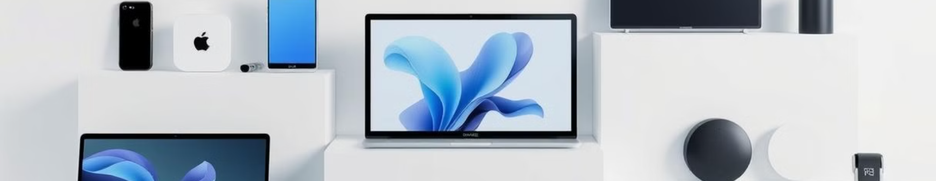




Our Product Range
Laptops
Tablets
Smartphones
Accessories
Powerful and portable solutions for work, entertainment, and beyond.
Versatile devices for on-the-go productivity and multimedia experiences.
Cutting-edge mobile devices that keep you connected and entertained.
A wide range of peripherals and add-ons to enhance your digital lifestyle.

Slide 4
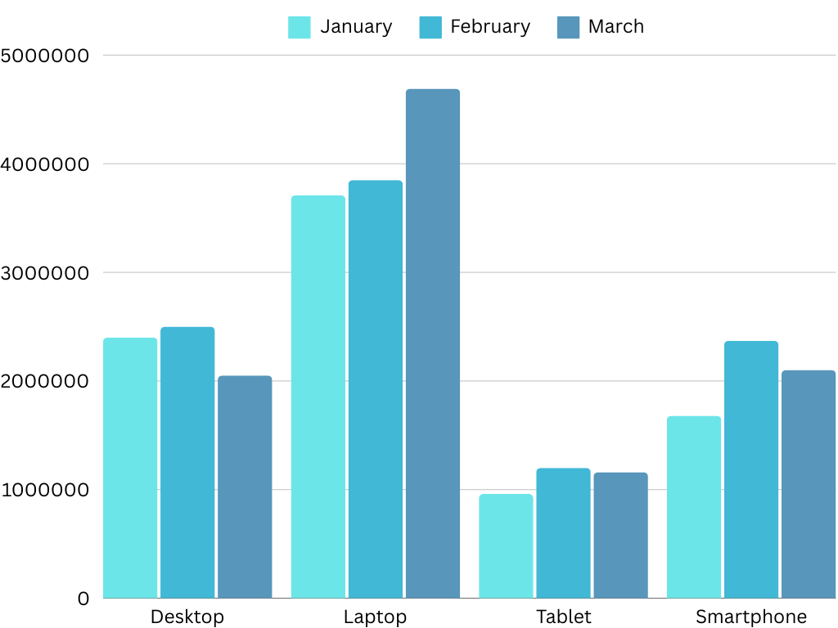
3-Month Sales Analysis
Month January
In January all the product has a decent sells, Laptops sold the most among all the products
Month February
In February the sales of all products increased compared to last month.
Month March
In March the sales of Desktop, Tables and Smartphones decreased but the sales of Laptops increased enormously compared to last two months

Slide 5

Conclusion
Bright Future
Customer-Centric Approach
Gadget Grit is poised for continued success, delivering cutting-edge technology and exceptional customer experiences.
We prioritize understanding our clients' needs and tailoring our solutions to empower their digital journeys.
Contact Information
Headquarters:1234 Tech Avenue, Suite 101Silicon City, Techland 56789
Contact Information:
Phone: +1 (555) 123-4567
Email: support@gadgetgrit.com
Website: www.gadgetgrit.com
Customer Support:
Phone: +1 (555) 987-6543
Email: helpdesk@gadgetgrit.com
Operating Hours: Monday - Friday, 9 AM to 6 PM (PST)
Social Media:
Twitter: @GadgetGrit
Facebook: facebook.com/GadgetGrit
LinkedIn: linkedin.com/company/gadgetgrit

